Slide 1



UNIT 2; My family and friends
Look back 2

Slide 2
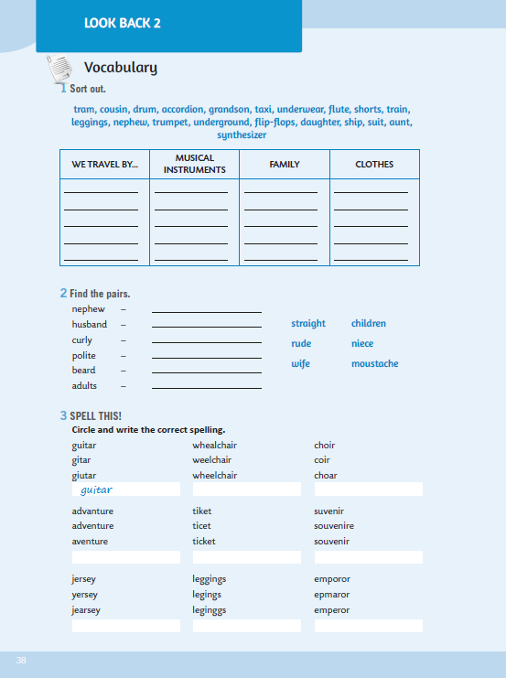
WB, page 38.
It’s the end of Unit 2!
Prisjetimo se da smo ponovili i proširili vokabular vezan za članove obitelji, opisivanje ljudi, prijevozna sredstva, odjeću i glazbene instrumente. Naučili smo koristiti glagol CAN, te ponovili razliku između izraza THERE IS i THERE ARE. Osim toga naučili smo iWH- riječi, te kako izraziti pripadanje!

Slide 3

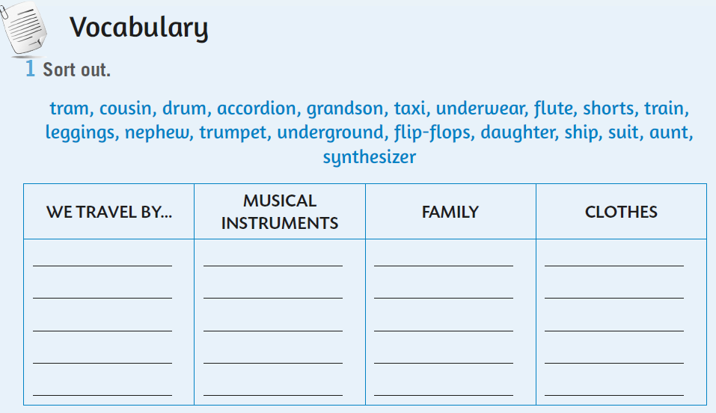
In task 1, you need to sort out the words.
GLAZBENI INSTRUMENTI
PUTUJEMO SA…
ČLANOVI OBITELJI
ODJEĆA I OBUĆA
tram
drum
cousin
underwear

Slide 4

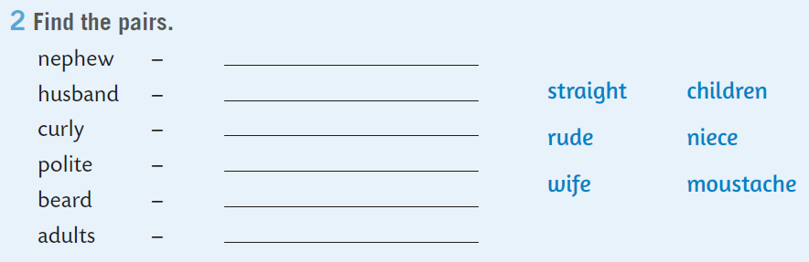
Find the pairs.
muški rod
niece
ženski rod

Slide 5

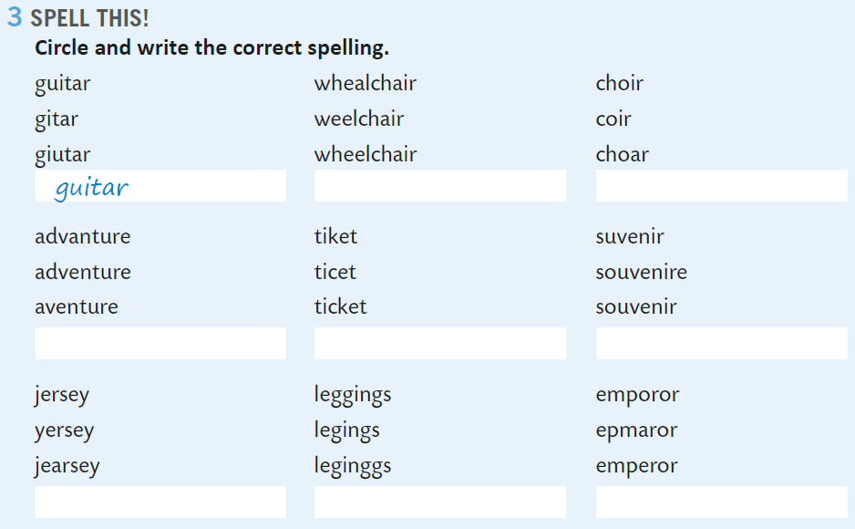

Next task deals with spelling. You have to circle and write the correct spelling.
Practice here: https://www.e-sfera.hr/dodatni-digitalni-sadrzaji/e50174e8-8590-46c5-82ac-ef72da6b640d/
wheelchair

Slide 6
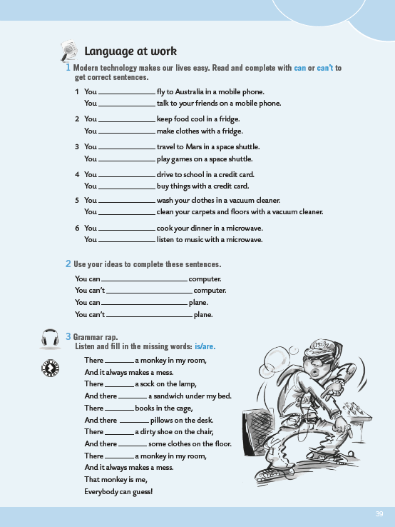
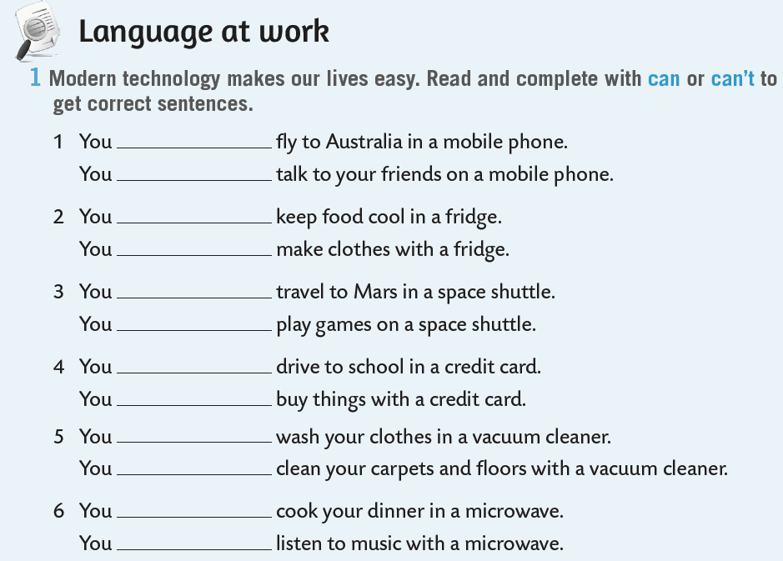
Modern technology makes our lives easy. Read and complete with can or can’t to get correct sentences.
can’t
can

Slide 7
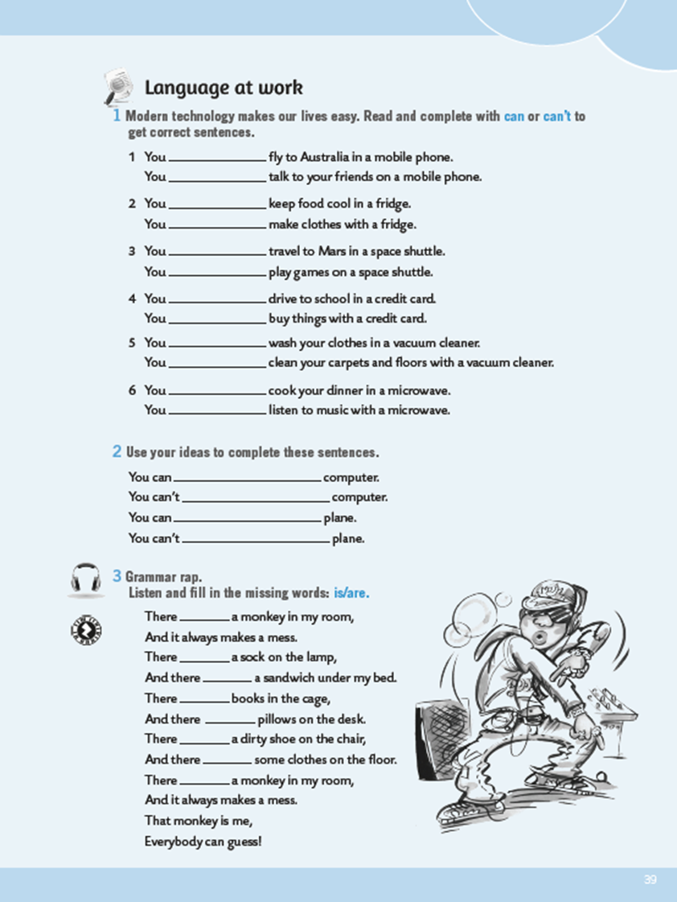
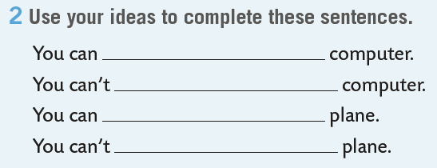
Use your ideas to complete these sentences.

Slide 8

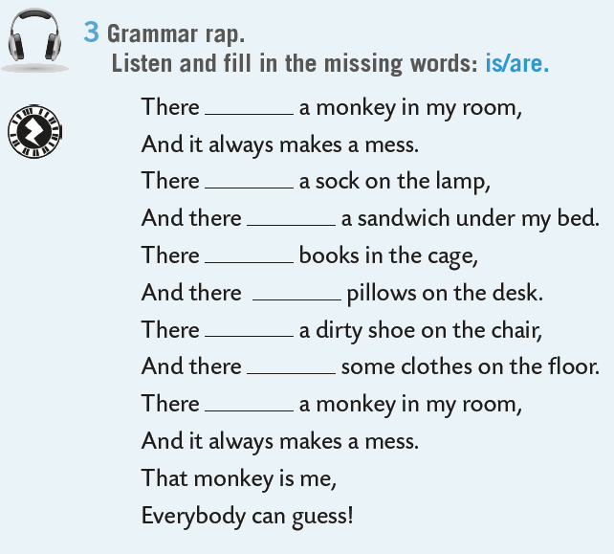

Check here: https://www.e-sfera.hr/dodatni-digitalni-sadrzaji/e50174e8-8590-46c5-82ac-ef72da6b640d/assets/audio/look_back_2_-grammar_rap.mp3
is
is
is
are
are
is
are
is

Slide 9
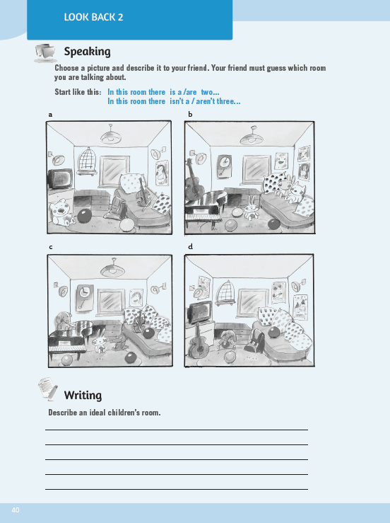
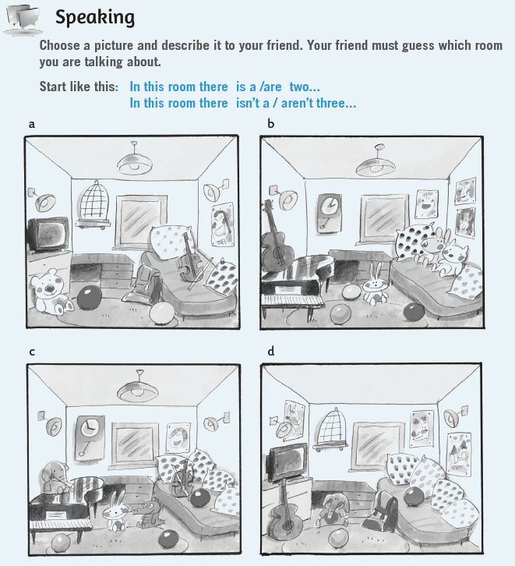
Look at the pictures in the speaking section. Call one of your friends from class and describe one of the rooms to him/her. Your friend must guess which room you are talking about.
In this room there are three balls on the floor.
…

Slide 10

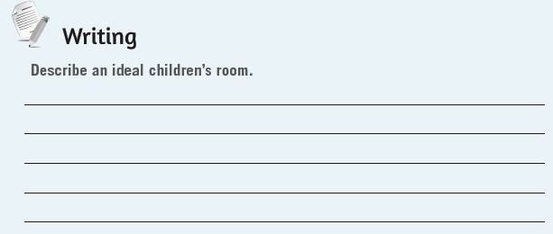
Describe an ideal children’s room.

Slide 11
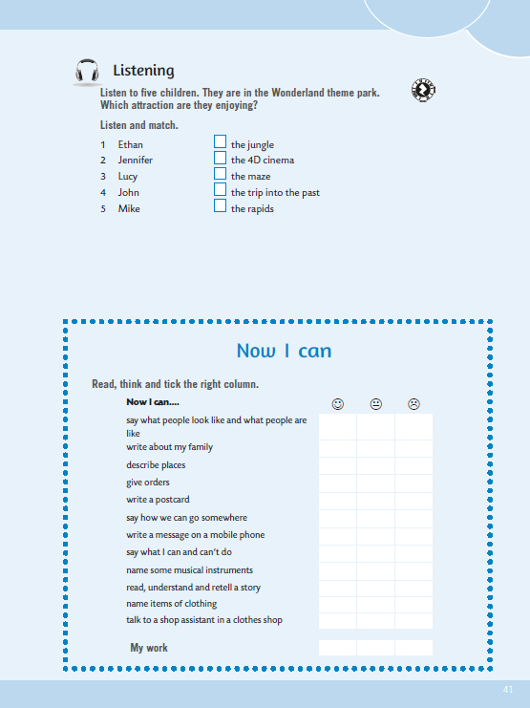
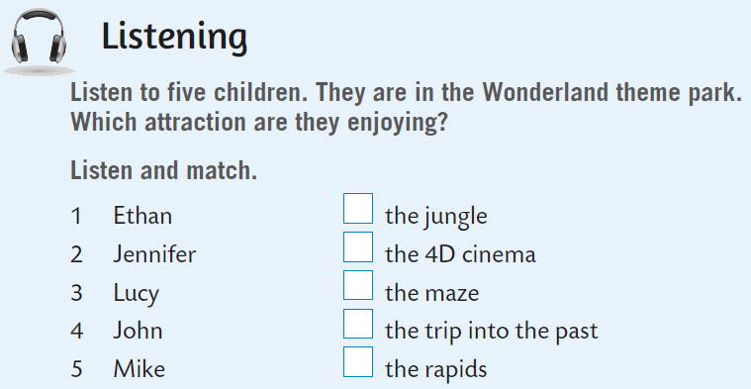
Listen and match. Then check: https://www.e-sfera.hr/dodatni-digitalni-sadrzaji/e50174e8-8590-46c5-82ac-ef72da6b640d/assets/audio/look_back_2a_-_five_children-wonderland_6.mp3
1

Slide 12
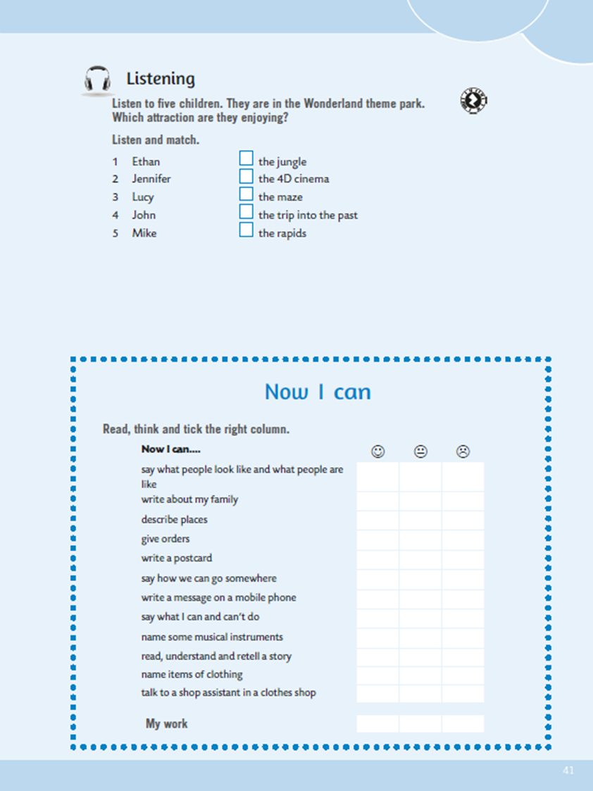
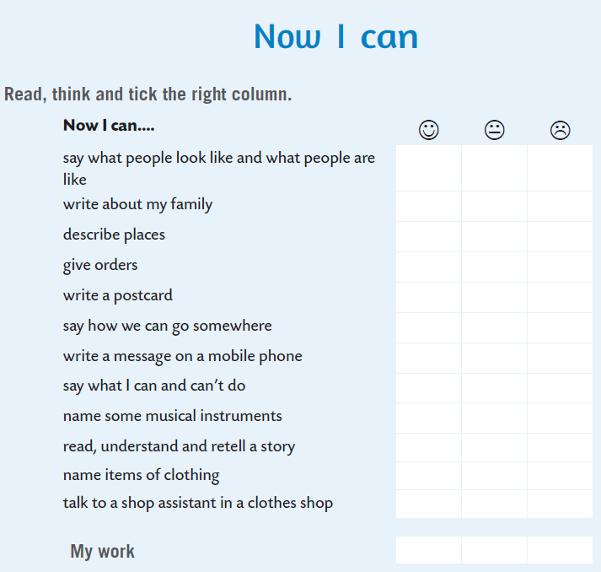



Now you can slef-evaluate. Read the sentences, think and tick the right column.
- izreći kako ljudi izgledaju i kakvi su
- pisati o svojoj obitelji
- opisati mjesta
- davati naredbe
- napisati razglednicu
- izreći kako možemo putovati
- napisati poruku na mobitelu
- izreći što možemo, a što ne možemo
- imenovati neke glazbene instrumente
- pročitati, razumjeti i prepričati priču
- imenovati odjevne predmete
- razgovarati sa prodavačem u trgovini odjećom

